Slide 1

Detecting Major Depressive Disorder using machine learning algorithms to classify MRI brain scans
By: Faraaz Rahman

Slide 2
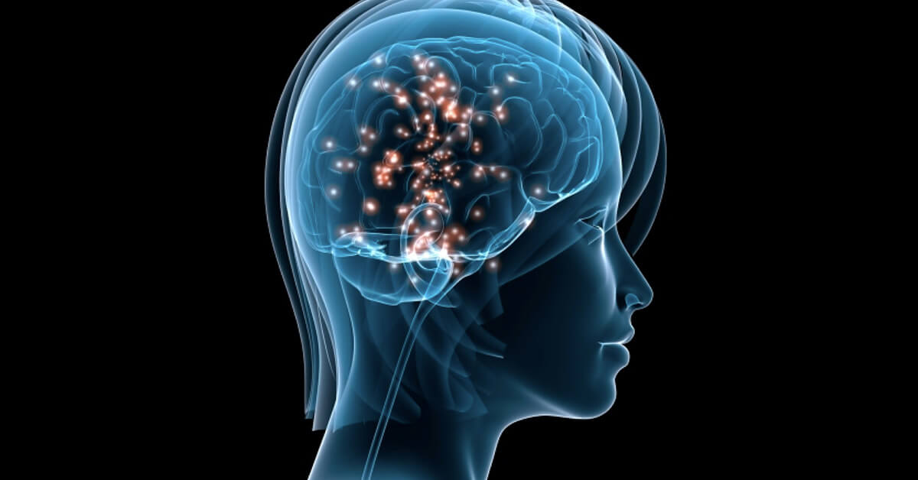
Purpose
300 million people all over the world have major depressive disorder (MDD)
MDD leads to suicide
In 2018, 100K people commit suicide
Accurately determine if someone has MDD
To detect and predict major depressive disorder early on

Slide 3
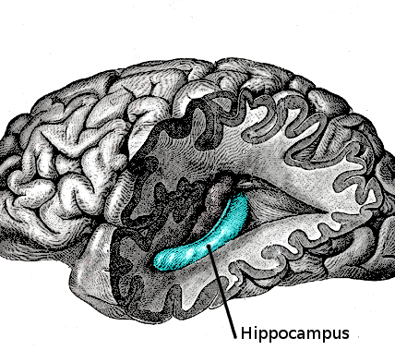
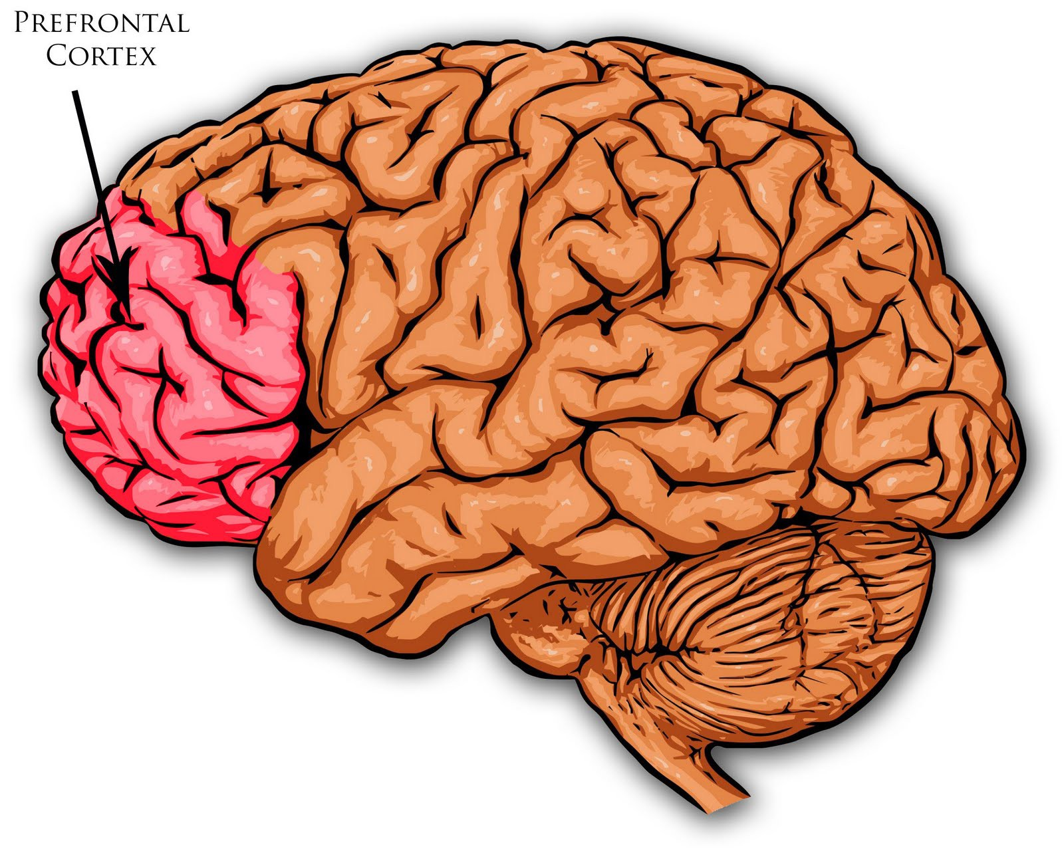
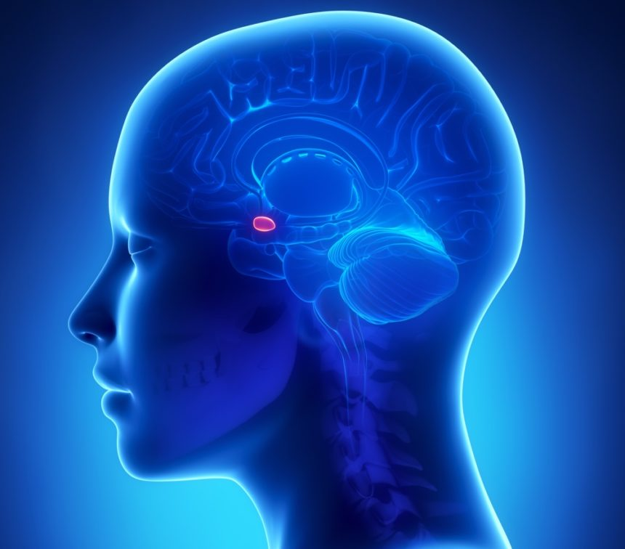
How is this possible?
Hippocampus
Excessive cortisol is sent to the brain during depression
An area in the dentate gyrus has neurons
When the dentate gyrus is exposed to too much cortisol, the neurons in the hippocampus decrease in volume and shrink
When excess cortisol is produced, prefrontal cortex shrinks
The amygdala enlarges when in constant exposure of cortisol
Prefrontal cortex
Amygdala

Slide 4
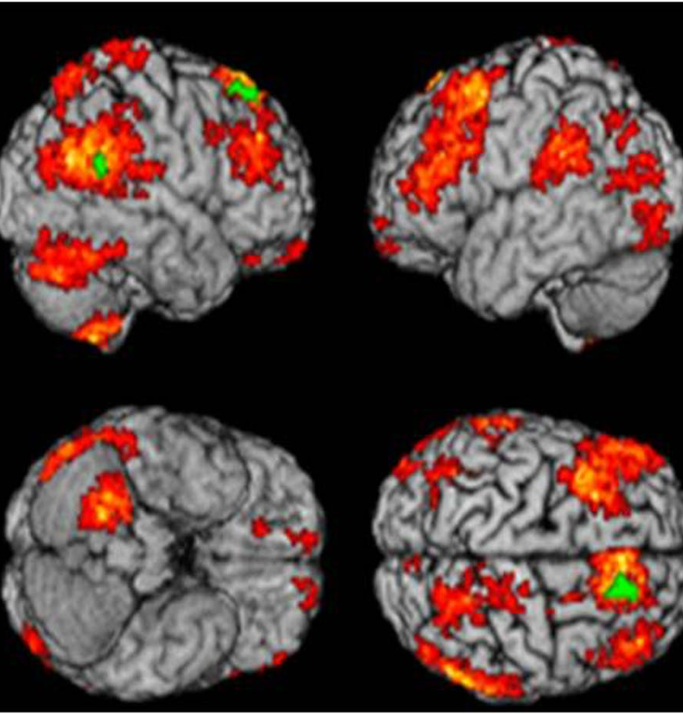
Past Research
Analysing brain scan images to diagnose bipolar disorder (Accuracy 80%)
Using a convolutional neural network to detect major depressive disorder (Accuracy 70%)
Using fMRI to see the change in a brain after listening to music
Does not:
Use structural MRI images
Looking for volume changes in the 3 said sections
Use various machine learning algorithms to find the optimal solution

Slide 5
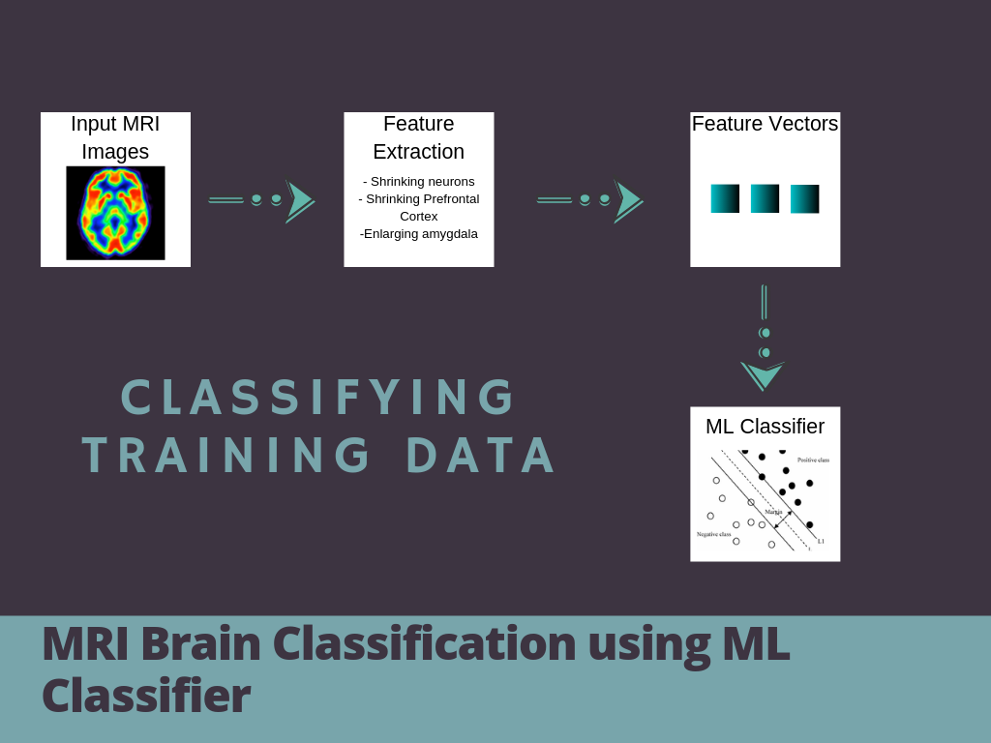
How am I going to do this?
To classify the images, multiple machine learning algorithms will be used
MRI data gathered from open source data sets and features will be extracted into a table format
Defining the feature vectors
Apply various supervised learning classifiers

Slide 6
References
“Major Depression.” National Institute of Mental Health, U.S. Department of Health and Human Services, www.nimh.nih.gov/health/statistics/major-depression.shtml.
He H, Sui J, Du Y, et al. Co‐altered functional networks and brain structure in unmedicated patients with bipolar and major depressive disorders. BrainStruct Funct, 2017.
Patel MJ, Khalaf A, Aizenstein HJ. Studying depression using imaging and machine learning methods. Neuroimage Clin. 2016.
Patel, Meenal J. Studying Depression Using Imaging and Machine Learning Methods. 11 Mar. 2015, doi.org/10.1016/j.nicl.2015.11.003.
Statnikov, Alexander. “A Gentle Introduction to Support Vector Machines in Biology.” ECE/CIS, www.eecis.udel.edu/~shatkay/Course/papers/UOSVMAlliferisWithoutTears.pdf.

Slide 7
References
Gao S, Calhoun VD, Sui J (2018): Machine learning in major depression: From classification to treatment outcome prediction. CNS Neurosci Ther. . doi: 10.1111/cns.13048.
Hilbert K, Lueken U, Muehlhan M, Beesdobaum K. Separating generalized anxiety disorder from major depression using clinical, hormonal, and structural MRI data: a multimodal machine learning study. Brain Behav. 2017;7(3):e00633.
Rubin‐Falcone H, Zanderigo F, Thapa‐Chhetry B, et al. Pattern recognition of magnetic resonance imaging‐based gray matter volume measurements classifies bipolar disorder and major depressive disorder. J Affect Disord. 2017;227(Supplement C):498‐505.
Sankar A, Zhang T, Gaonkar B, et al. Diagnostic potential of structural neuroimaging for depression from a multi‐ethnic community sample. BJPsych open. 2016;2(4):247‐254.
Schnyer DM, Clasen PC, Gonzalez C, Beevers CG. Evaluating thediagnostic utility of applying a machine learning algorithm to diffusion tensor MRI measures in individuals with major depressive disorder. Psychiatry Res. 2017;264:1.
Zhong X, Shi H, Ming Q, et al. Whole‐brain resting‐state functional connectivity identified major depressive disorder: a multivariate pattern analysis in two independent samples. J Affect Disord. 2017;218:346‐352.

Slide 8



+1 23 987 6554
april@www.proseware.com
www.proseware.com

